Slide 1
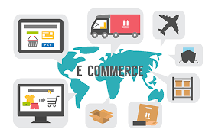
E-Commerce Development using OpenSource- Magento
Syllabus
Unit- 1 Planning for Magento Installation
Scope, Global-Website-Store Methodology, Planning Multiple
Stores, Key to successful installation.
Setting up Magento Stores, Planning
categories, strategies for backup and
security, Magento Installation and
features

Slide 2
E-Commerce Development using OpenSource- Magento
Syllabus
Unit- 2 Magento Products
Catalogs and Categories, Managing Products, related products, up-sells and cross-sells, Importing products, Magento products, Product Imports, Quantity, Categories, Special prices, orders.

Slide 3
E-Commerce Development using OpenSource- Magento
Syllabus
Unit- 3 Designs and Themes
Theme Structure, Installing third party themes, Creative translations, using theme variants, Customizing themes,
Magento-themes, CMS, SSL, Customer Management.

Slide 4
E-Commerce Development using OpenSource- Magento
Syllabus
Unit- 4 Revenue Generation
Sales Process, Payment methods, Shipping methods, Configuring sales tax rules, Outgoing e-mails, Magento Modules- Shipping modules and Payment Modules.

Slide 5
E-Commerce Development using OpenSource- Magento
Syllabus
Unit- 5 Managing Non-product Content
Magento Content Management System- Pages, Static blocks, widgets, Principles of customizing layouts, Magento-Issues, News Letter, SEO for Magento, Google Analytics for Magento, Importing and Exporting

Slide 6

Introduction to Electronic Commerce

Slide 7

Objectives
Identify several advantages of e-commerce
Outline a multistage model that describes how e-commerce works
Identify several e-commerce applications

Slide 8
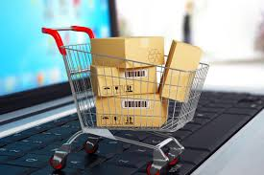
In this chapter, you will learn about:
What Electronic Commerce (E-Commerce)?
What are the important aspects of E-Commerce?
Categories of E-Commerce.
Multi-Stage Model for E-Commerce
E-Commerce Challenges & Applications
E-Commerce Advantages and Disadvantages

Slide 9

WHAT IS COMMERCE???
According to Dictionary.com
Commerce is a division of trade or production which deals with the exchange of goods and services from producer to final consumer
It comprises the trading of something of economic value such as goods, services, information, or money between two or more entities.

Slide 10
Electronic Commerce
Electronic commerce (e-commerce)
  Businesses trading with other businesses and internal processes
E-commerce is a new way of conducting business, and as with any other new application of technology, it presents both opportunities for improvement and potential problems
Electronic business (e-business)
  Term used interchangeably with e-commerce
  The transformation of key business processes through the use of Internet technologies

Slide 11
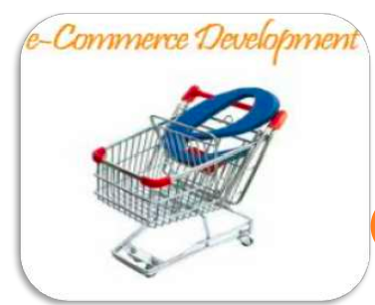
WHAT IS E-COMMERCE???
Commonly known as Electronic Marketing.
“It consist of buying and selling goods and services over an electronic systems Such as the internet and other computer networks.”
“E-commerce is the purchasing, selling and exchanging goods and services over computer networks (internet)through which transaction or terms of sale are performed electronically

Slide 12
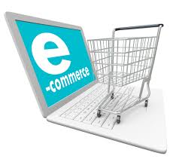
Why Use
E-Commerce??
LOW ENTRY COST
REDUCES TRANSACTION COSTS
ACCESS TO THE GLOBAL MARKET
SECURE MARKET SHARE

Slide 13

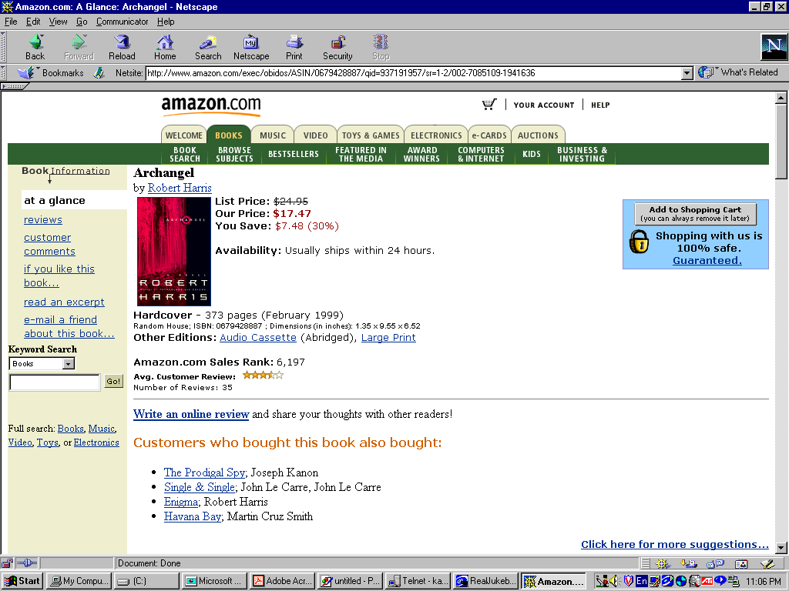
SECURITY
CONTENT
PRESENTATION
Dr. Thomas Tran
CSI 5389 (E-Commerce Technologies)
Notes:
Let’s us look at amazon.com as an example of an e-commerce store
This site shows an item (i.e. a book) on sale with necessary information such as title, author, price, shipping information etc. This is what we call “content presentation” of an e-commerce store
The site also presents “security feature”, which is of course very important to any online purchaser

Slide 14
TRANSACTION
PROCESSING
RECOMMENDER
SYSTEMS
Dr. Thomas Tran
CSI 5389 (E-Commerce Technologies)
Notes:
Amazon.com also has a built-in “recommender system”, which suggests other items for the customer to buy in addition to the presented item
An e-commerce store must have facility to process a transaction, e.g., allowing customers to place items in a shopping cart, to pay for their chosen items, to access their accounts etc.

Slide 15
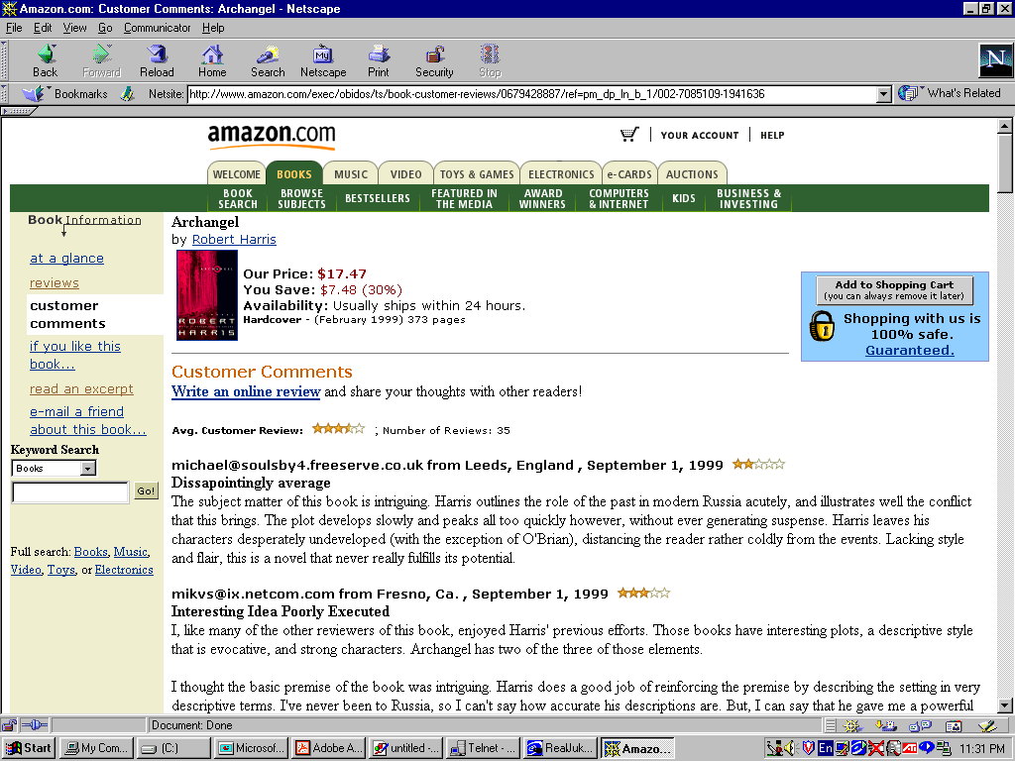
ELECTRONIC
COMMUNITY
Dr. Thomas Tran
CSI 5389 (E-Commerce Technologies)
Notes:
Nowadays, many e-commerce store also establish online communities or forums via which customers can post and exchange their opinions and comments on the store’s products

Slide 16

Categories of Electronic Commerce
Five general e-commerce categories:
  Business-to-consumer
  Business-to-business
  Business processes
  Consumer-to-consumer
  Business-to-government
Supply management or procurement
  Departments are devoted to negotiating purchase transactions with suppliers

Slide 17

Categories of Electronic Commerce (continued)
Transaction
  An exchange of value
Business processes
  The group of logical, related, and sequential activities and transactions in which businesses engage
Telecommuting or telework
  Employees log in to company computers through the Internet instead of traveling to the office

Slide 18
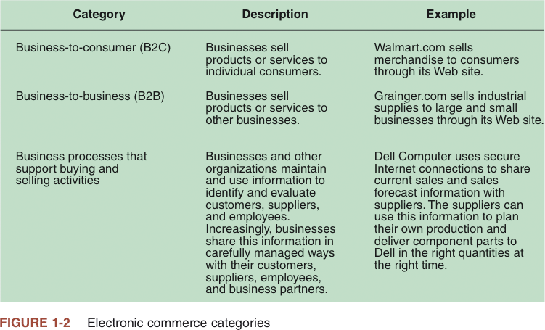

Slide 19
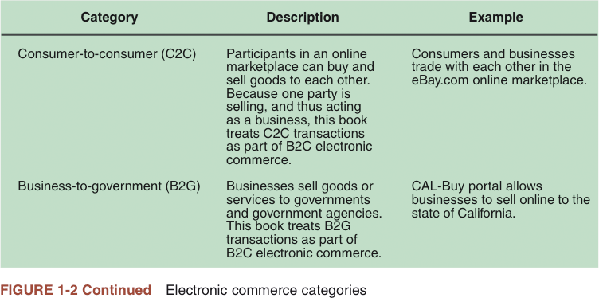

Slide 20
Business-to-consumer (B2C) e-commerce: customers deal directly with the organization, avoiding any intermediaries
Business-to-business (B2B) e-commerce: participants are organizations
Consumer-to-consumer (C2C) e-commerce: participants are individuals, with one serving as the buyer and the other as the seller

Slide 21

THE PROCESS OF
E-COMMERCE
A consumer uses Web browser to connect to the home page of a merchant's Web site on the Internet.
The consumer browses the catalog of products featured on the site and selects items to purchase. The selected items are placed in the electronic equivalent of a shopping cart.
When the consumer is ready to complete the purchase of selected items, she provides a bill-to and ship-to address for purchase and delivery

Slide 22
When the merchant's Web server receives this information, it computes the total cost of the order--including tax, shipping, and handling charges--and then displays the total to the customer.
The customer can now provide payment information, such as a credit card number, and then submit the order.
When the credit card number is validated and the order is completed at the Commerce Server site, the merchant's site displays a receipt confirming the customer's purchase.
The Commerce Server site then forwards the order to a Processing Network for payment processing and fulfillment.

Slide 23

Multistage Model for E-commerce
Search and identification
Selection and negotiation
Purchasing products and services electronically
Product and service delivery
After-sales service

Slide 24
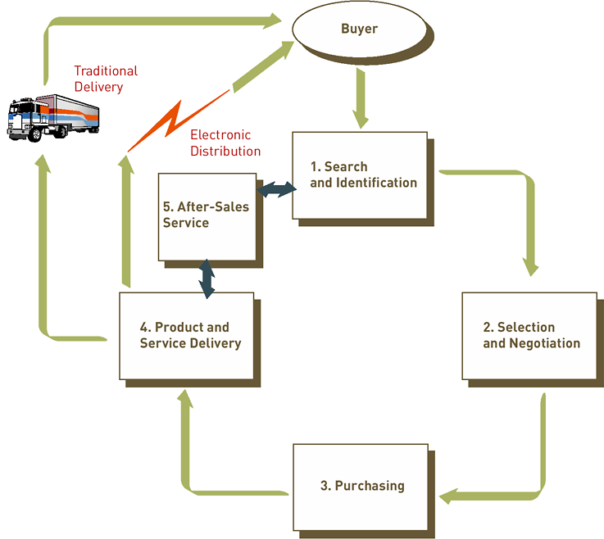
Multistage Model for E-Commerce (B2B and B2C)

Slide 25
E-Commerce Challenges
Define an effective e-commerce model and strategy
Need to change distribution systems and work processes
Integrate Web-based order processing with traditional systems

Slide 26
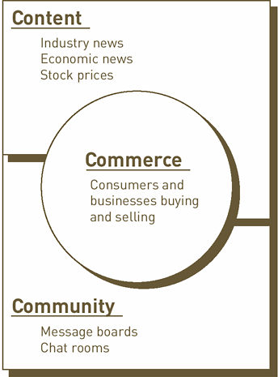
Three Basic Components of a Successful E-Commerce Model

Slide 27
E-Commerce Applications: Retail and Wholesale
Electronic retailing (e-tailing): the direct sale from business to consumer through electronic storefronts, typically designed around an electronic catalog and shopping cart model
Cybermall: a single Web site that offers many products and services at one Internet location
Manufacturing, repair, and operations (MRO) goods and services

Slide 28
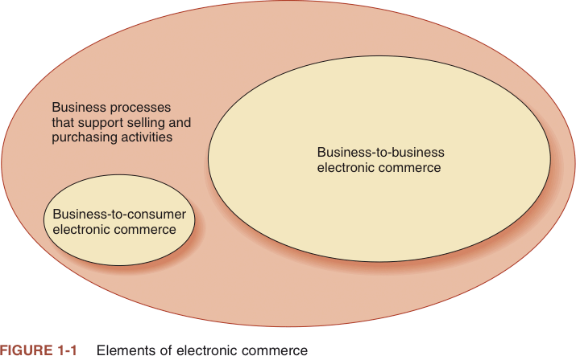

Slide 29
The Development and Growth of Electronic Commerce
Electronic funds transfers (EFTs)
  Also called wire transfers
  Electronic transmissions of account exchange information over private communications networks
Electronic data interchange (EDI)
  Transmitting computer-readable data in a standard format to another business

Slide 30
The Development and Growth of Electronic Commerce (continued)
Trading partners
  Businesses that engage in EDI with each other
Value-added network (VAN)
  Independent firm that offers connection and transaction-forwarding services to buyers and sellers engaged in EDI

Slide 31
E-Commerce Software
Catalog management
Product configuration
Shopping cart facilities
E-commerce transaction processing
Web traffic data analysis

Slide 32
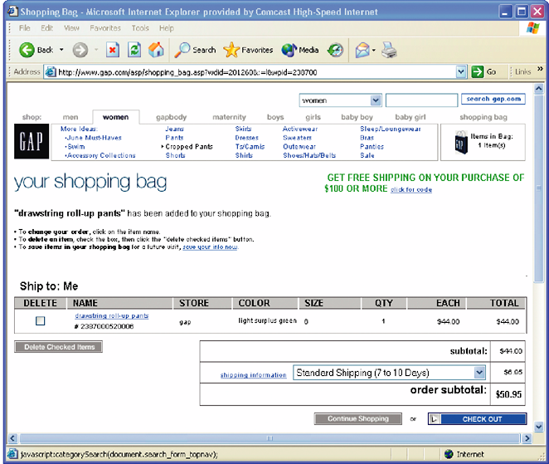
Figure 8.8: Electronic Shopping Cart

Slide 33
E-Commerce Transaction Processing
E-commerce transaction processing software: connects participants in the e-commerce economy and enables communication between trading partners, regardless of their technical infrastructure
Fully automates transaction processes from order placement to reconciliation
Web site traffic data analysis software: processes and analyzes data from the Web log file to provide useful information to improve Web site performance

Slide 34
Electronic Payment Systems
Digital certificate: an attachment to an e-mail message or data embedded in a Web page that verifies the identity of a sender or a Web site
Certificate authority (CA): a trusted third party that issues digital certificates
Secure Sockets Layer (SSL): a communications protocol used to secure sensitive data
Electronic cash: an amount of money that is computerized, stored, and used as cash for e-commerce transactions

Slide 35
Electronic Payment Systems (continued)
Electronic wallet: a computerized stored value that holds credit card information, electronic cash, owner identification, and address information
Credit card
Charge card
Debit card
Smart card

Slide 36
Threats to E-Commerce
E- and m-commerce incidents
Theft of intellectual property
  Intellectual property: music, books, inventions, paintings, and other special items protected by patents, copyrights, or trademarks
  Patents on business processes

Slide 37
Advantages of Electronic Commerce
Electronic commerce can increase sales and decrease costs
If advertising is done well on the Web, it can get a firm’s promotional message out to potential customers in every country
Using e-commerce sales support and order-taking processes, a business can:
  Reduce costs of handling sales inquiries
  Provide price quotes

Slide 38
Advantages of Electronic Commerce (continued)
It increases purchasing opportunities for buyers
Negotiating price and delivery terms is easier
The following cost less to issue and arrive securely and quickly:
  Electronic payments of tax refunds
  Public retirement
  Welfare support

Slide 39
Disadvantages of Electronic Commerce
Perishable grocery products are much harder to sell online
It is difficult to:
  Calculate return on investment
  Integrate existing databases and transaction-processing software into software that enables e-commerce
Cultural and legal obstacles also exist

Slide 40
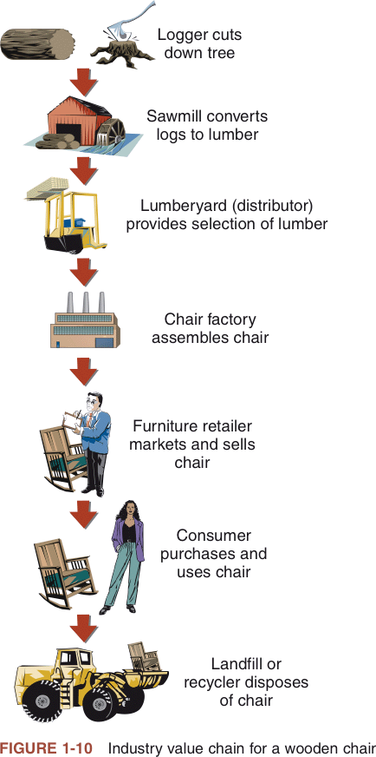

Slide 41
